Slide 1
“Round-trip over the Ocean” (1990) Sakiyama Tami (1954-)
水上往還
崎山多美

Slide 2
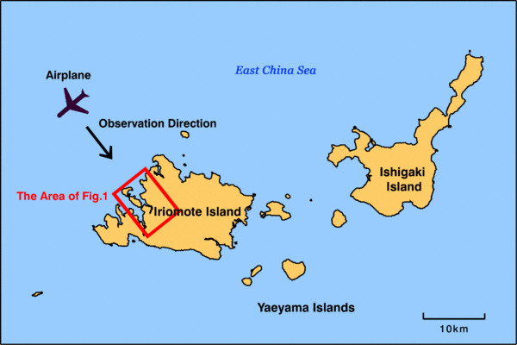
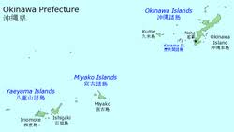
Maps

Slide 3
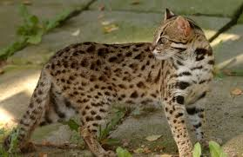
Iriomote yamaneko (Mountain Cat)

Slide 4
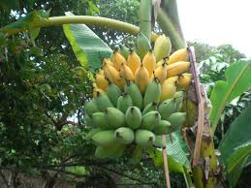
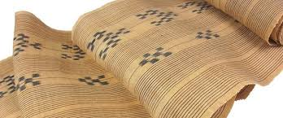
Mountain banana & bashôfu textile

Slide 5
Keywords
Island stories, unrelated to healing (iyashi) discourse & Okinawa boom
memory
T/O; Iriomote & Ishigaki
Coalmines (1896-), malaria
Depopulation
Ecotourism, Iriomote mountain cat
Eldest son, mortuary tablet (ihai), yuta shaman
Guilt, betrayal, tradition, modernization, identity
Shiga Naoya & Joseph Conrad (In the Heart of Darkness)
Writing and representation

Slide 6
Discussion Questions
What, if any, is the rhetorical effect of the author’s deliberate reversal of spatial directions?
Discuss the ties each generation of Akiko’s family has to their home island (Makato, Kinzô, Akiko)
What is the significance of Matsuo who figures in the story within the story?
Explain the story’s conclusion. Why does Akiko throw away the mortuary tablet she and her father have come to retrieve?

